Slide 1
The “Roaring Twenties”
1919-1929

Slide 2
Standards
SSUSH15 The student will analyze the origins and impact of U.S. involvement in World War I.
d. Describe passage of the Eighteenth Amendment, establishing Prohibition, and the Nineteenth Amendment, establishing woman suffrage.
SSUSH16 The student will identify key developments in the aftermath of WW I.
b. Identify Henry Ford, mass production, and the automobile.
c. Describe the impact of radio and the movies.
d. Describe modern forms of cultural expression; include Louis Armstrong and the origins of jazz, Langston Hughes and the Harlem Renaissance, Irving Berlin, and Tin Pan Alley.

Slide 3
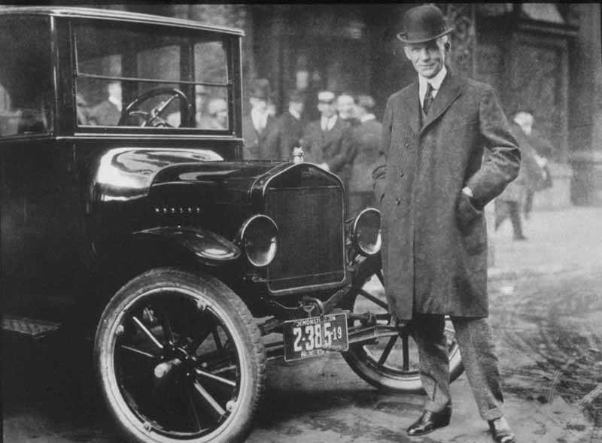
A Booming economy
Henry Ford – car manufacturer who transformed the American production process
Mass Production – rapid manufacture of large numbers of identical products
Model T – first automobile to be widely produced; easily affordable to most American families
Assembly line – arrangement of equipment and workers in which work passes from operation to operation in direct line until the product is assembled.

Slide 4
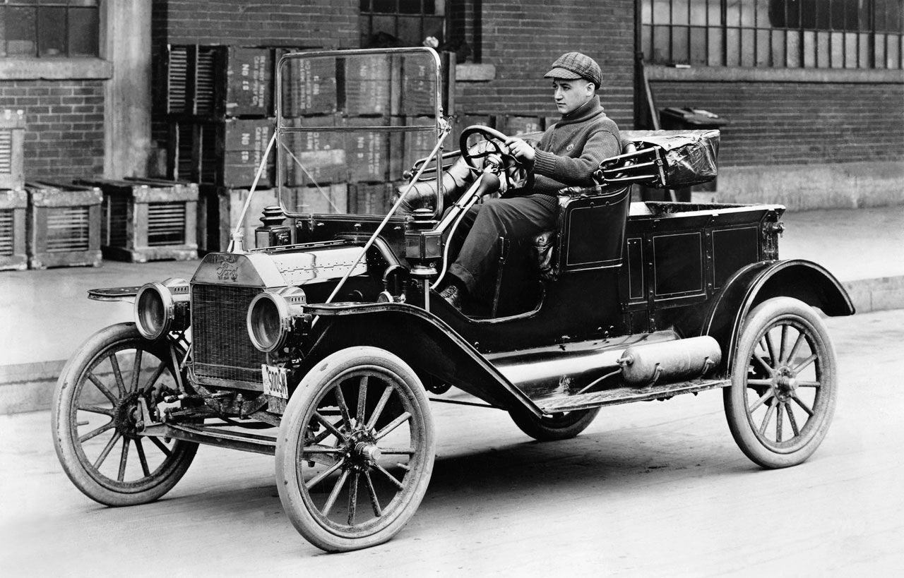

Slide 5
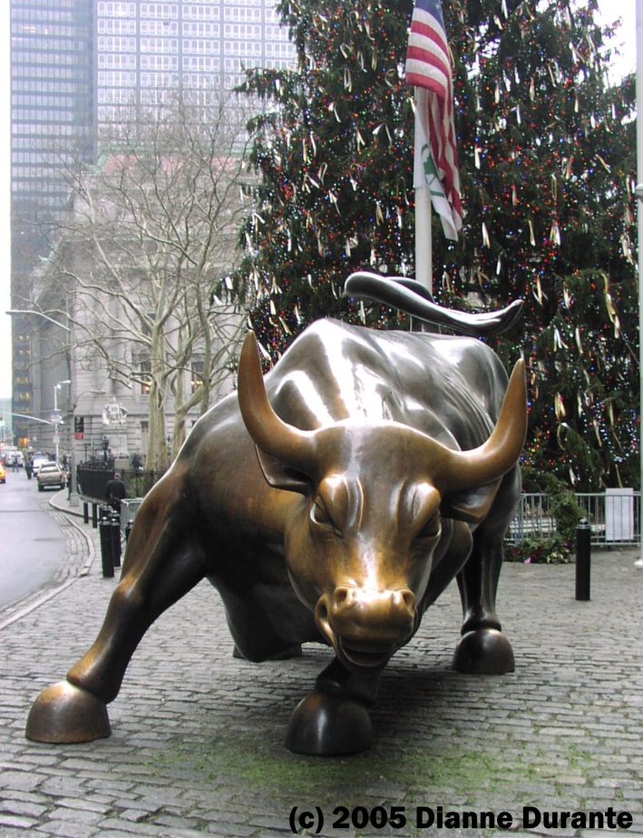
A Bustling Economy
The 1920’s saw a “consumer revolution”- many new, affordable goods became available to the public
Credit extended to more individuals than ever before – “Buy Now, Pay Later!”
Bull Market – period of rising stock prices
Bear Market – period of falling stock prices
Buying on Margin – paying as little as 10% down on stock purchases; $10 could buy $100 of stock

Slide 6
Society changes America
Prohibition – banning of alcohol use
Goal of the temperance movement since the mid 1800s
The 18th Amendment to the Constitution passed in 1919 forbade the “manufacture, distribution and sale” of alcohol anywhere in the United States
Issue divided the nation, particularly rural and urban Americans
Creation of “speakeasies”- secret bars and nightclubs that illegally served alcohol.

Slide 7
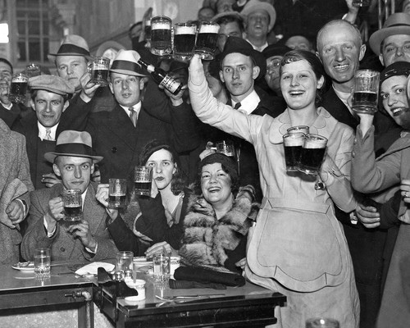
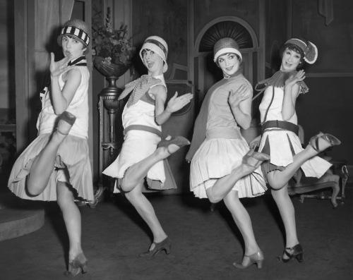
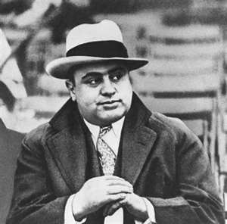
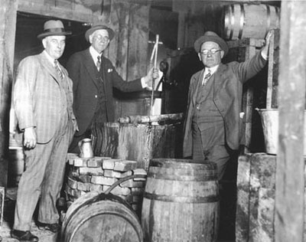

Slide 8
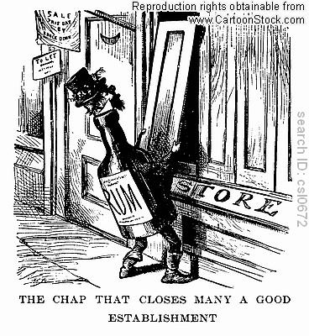

Slide 9
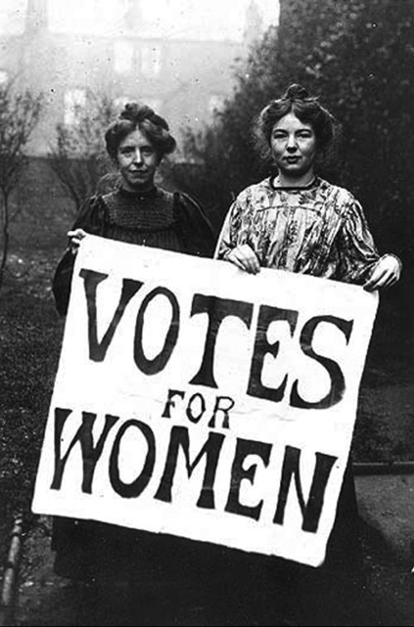
Society changes America
19th Amendment gives women the right to vote!
Efforts of suffragists like Elizabeth Cady Stanton, Lucretia Mott and Susan B. Anthony finally paid off in 1920
The importance of women to the war effort during WWI led many to see their vital role in society

Slide 10
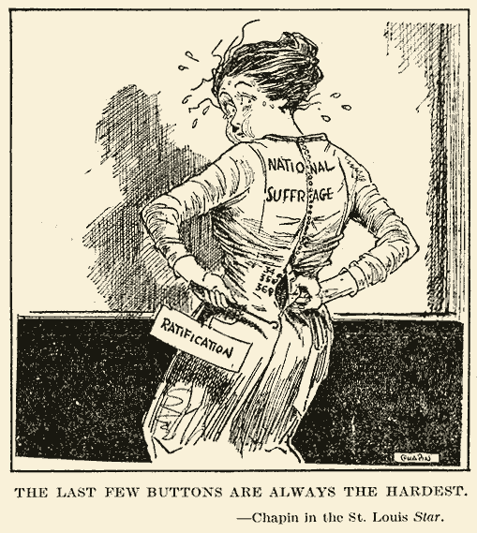

Slide 11
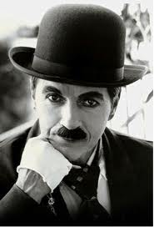
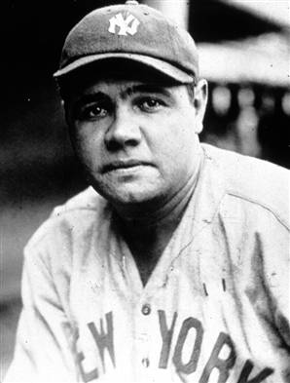
Radio and Motion Pictures Revolutionize popular culture
With the boom of the economy, more money flowed into the pockets of everyday citizens.
This extra income allowed Americans to purchase radios and telephones and attend social events and motion picture theaters.
Radios accelerated the development of product commercialism, provided immediate access to breaking news and broadcasts the latest music fads.
Before radio and movies politicians were the celebrities of the day. Now radio personalities, movie stars and athletes become celebrities.

Slide 12
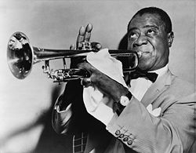
The Jazz Age
How did African Americans express themselves during the early 20th century?
The Jazz Age – emergence of jazz (a genre of music that combines elements of other styles and emphasizes improvisation)
New Orleans – cultural hearth of Jazz movement
Louis Armstrong – most famous jazz musician of the era

Slide 13
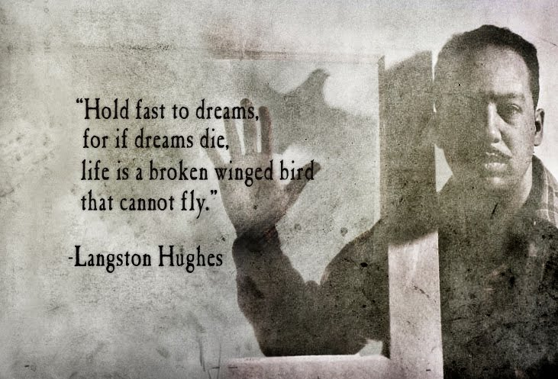
The Harlem Renaissance
How did African Americans express themselves during the early 20th century?
The Harlem Renaissance
“Explosion” of African American poetry, art and literature; centered around the neighborhood of Harlem in New York City
Langston Hughes – most famous African American writer of the era
This increase in African American literature and expression led to a new cultural identity for an entire race.
It exposed white culture to thoughts and feelings of the black community leading to further understanding of racial differences.

Slide 14
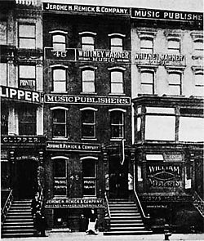
Tin Pan Alley
Tin Pin Alley – collection of New York music composers and producers who dominated the music industry at the turn of the 20th century
Piano bars and night time “hot spots” clustered around lower Manhattan in New York City increased demand for newly penned music and lyrics.
Popularity of “Tin Pan” declined with the rise of popular music via radio airplay.

Slide 15
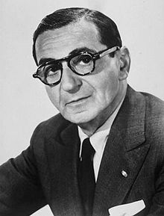
Irving Berlin
Irving Berlin
Considered by many to be one of the greatest songwriters of all time.
Penned such classics as:
“Blue Skies”
“White Christmas”
God Bless America”

